Slide 1
CHANNELS OF COMMUNICATION

Slide 2
COMMUNICATION NETWORKS
Formal Network : Virtually Vertical or Horizontal as per chain of command goes within the hierarchy.
Informal Network : Free to move in any direction may skip formal chain of command. Likely to satisfy social and emotional needs
and also can facilitate task accomplishment.

Slide 3
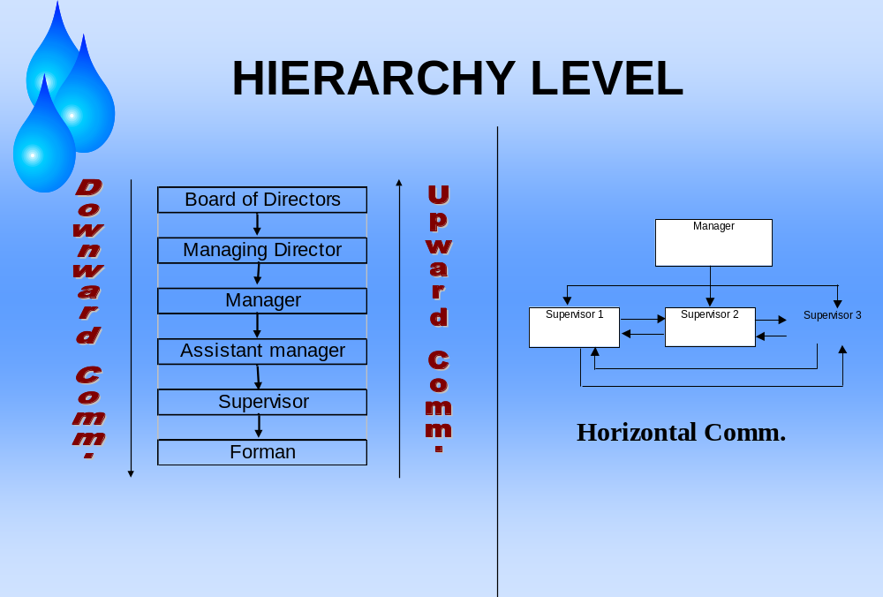

Slide 4
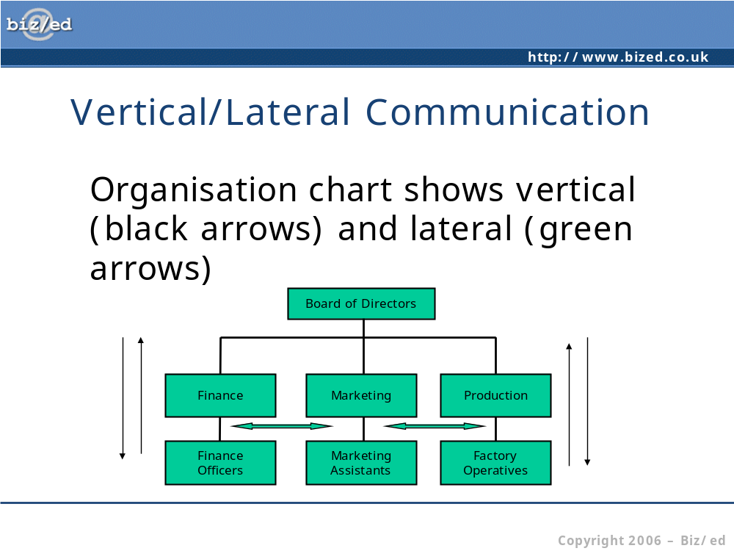


Slide 5
DOWNWARD COMM.
Used by group leaders or managers
Flows from superiors to subordinates
Highly directive
To assign goals, give job instructions, to inform, to offer feedback, to highlight problems etc.

Slide 6
How to make Downward Comm. Effective
Clear &complete idea of the message.
Policy decisions of the past.
Clear idea of aims &objective
Adequate volume & substance
Competence &understanding of subordinates
Appropriate Time
Neither over nor under comm.
No bypassing of any authority
Lines of Comm. should be short
Simple Language

Slide 7
Limitations of Downward Comm.
Delay
Message Abbreviation
Message distortion
Message overload
Incomplete Information

Slide 8
UPWARD COMM.
Flows from lower to higher level
To give feedback
To inform about progress/problems
Seeking approval

Slide 9
Methods and Policies of Upward Comm.
Meetings
Counseling
An open-door policy
Correspondence
Participation in social gatherings and group events
Suggestion boxes

Slide 10
Problems of Upward Comm.
Positive encouragement
Concealing unfavorable facts
Delay, Distortion and Filtering
Bypass and Suspicion
Poor Listening
Communicating Criticism

Slide 11
Effective Upward Comm.
Lines of Comm. should be kept short
Conduct employee attitude surveys
Formal system to handle suggestions
Eliminate the fear& awe of authority
Suggestions should be rewarded
Genuine concern for the problems of workers
Build a cooperate atmosphere of trust

Slide 12
HORIZONTAL COMM.
Among Colleagues and peers at same level
Used to share information
For Coordination
To save time

Slide 13
Methods of Effective Horizontal Comm.
Telephone or Face to face Comm.
Meetings
Written Media

Slide 14
INFORMALCOMMUNICATION
GRAPEVINE –
It is an informal channel of comm. which ignores all formal channels and spreads rumors and gossips.
It is neither pre- planned nor controlled by the management and at times more reliable than the formal channel.
It is also used to serve the self interest of the people within it.

Slide 15
LIMITATIONS OF GRAPEVINE
Some degree of error.
Baseless, imaginary and non-factual messages are harmful.
Self-serving information.
Incomplete information.
Spreads messages too swiftly.
No one takes the responsibility.

Slide 16
HOW TO USE GRAPEVINE
Presenting facts positively
Better job design &better quality of work life
Trust relationship with employees
Adequate access to information
Accurate and substantial information
Use it as a barometer of public interest
Avoid threatening the informal channel
Find people who are more active in grapevine
Manager should try to understand importance of informal human relationship

Slide 17
Organizational Barriers
Hierarchical Barriers
Specialization of the workforce
Communication Load
Wrong choice of medium

